Slide 1
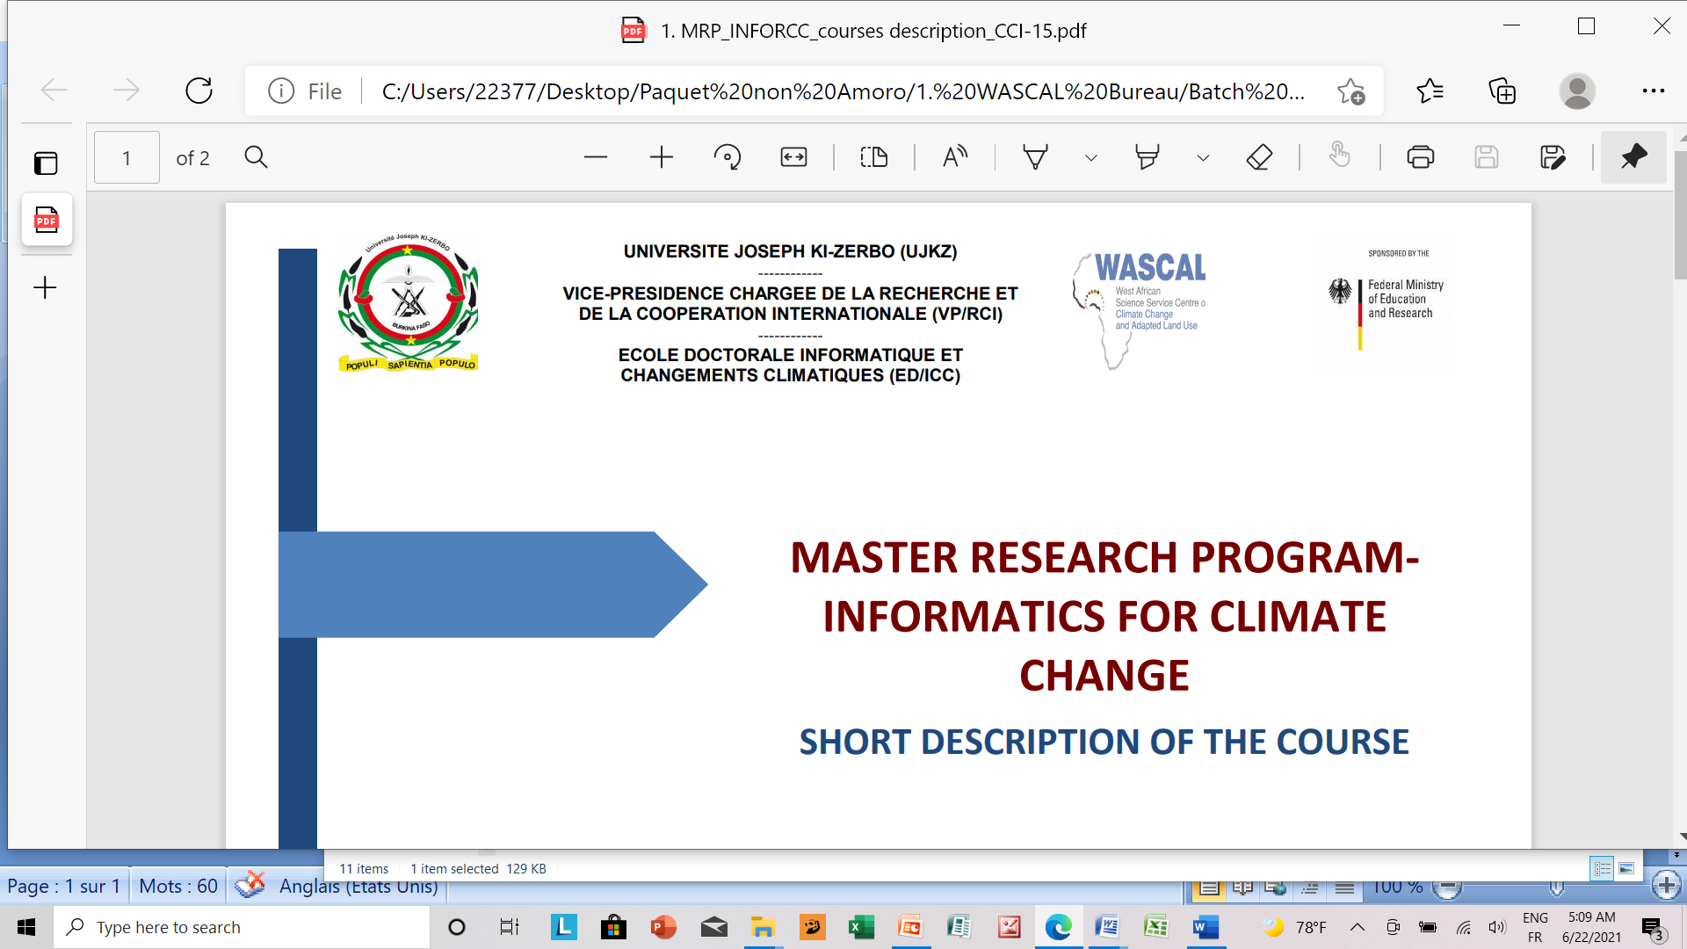
Evaluation of Microphysics (mp) Schemes in WRF Model for Simulating Key Climate Variables over West Africa. Assessment of Consecutive Dry Days (CDD) in West Africa: Model Evaluation and Climate Projections
Presented by
IBRAHIM SAVADOGO

Slide 2
Outline
I
Introduction
II
Background of the Study
III
Objectives
IV
Study Area
V
Data and Methods
VI
Results and Discussions
VII
Conclusion and recommandations

Slide 3
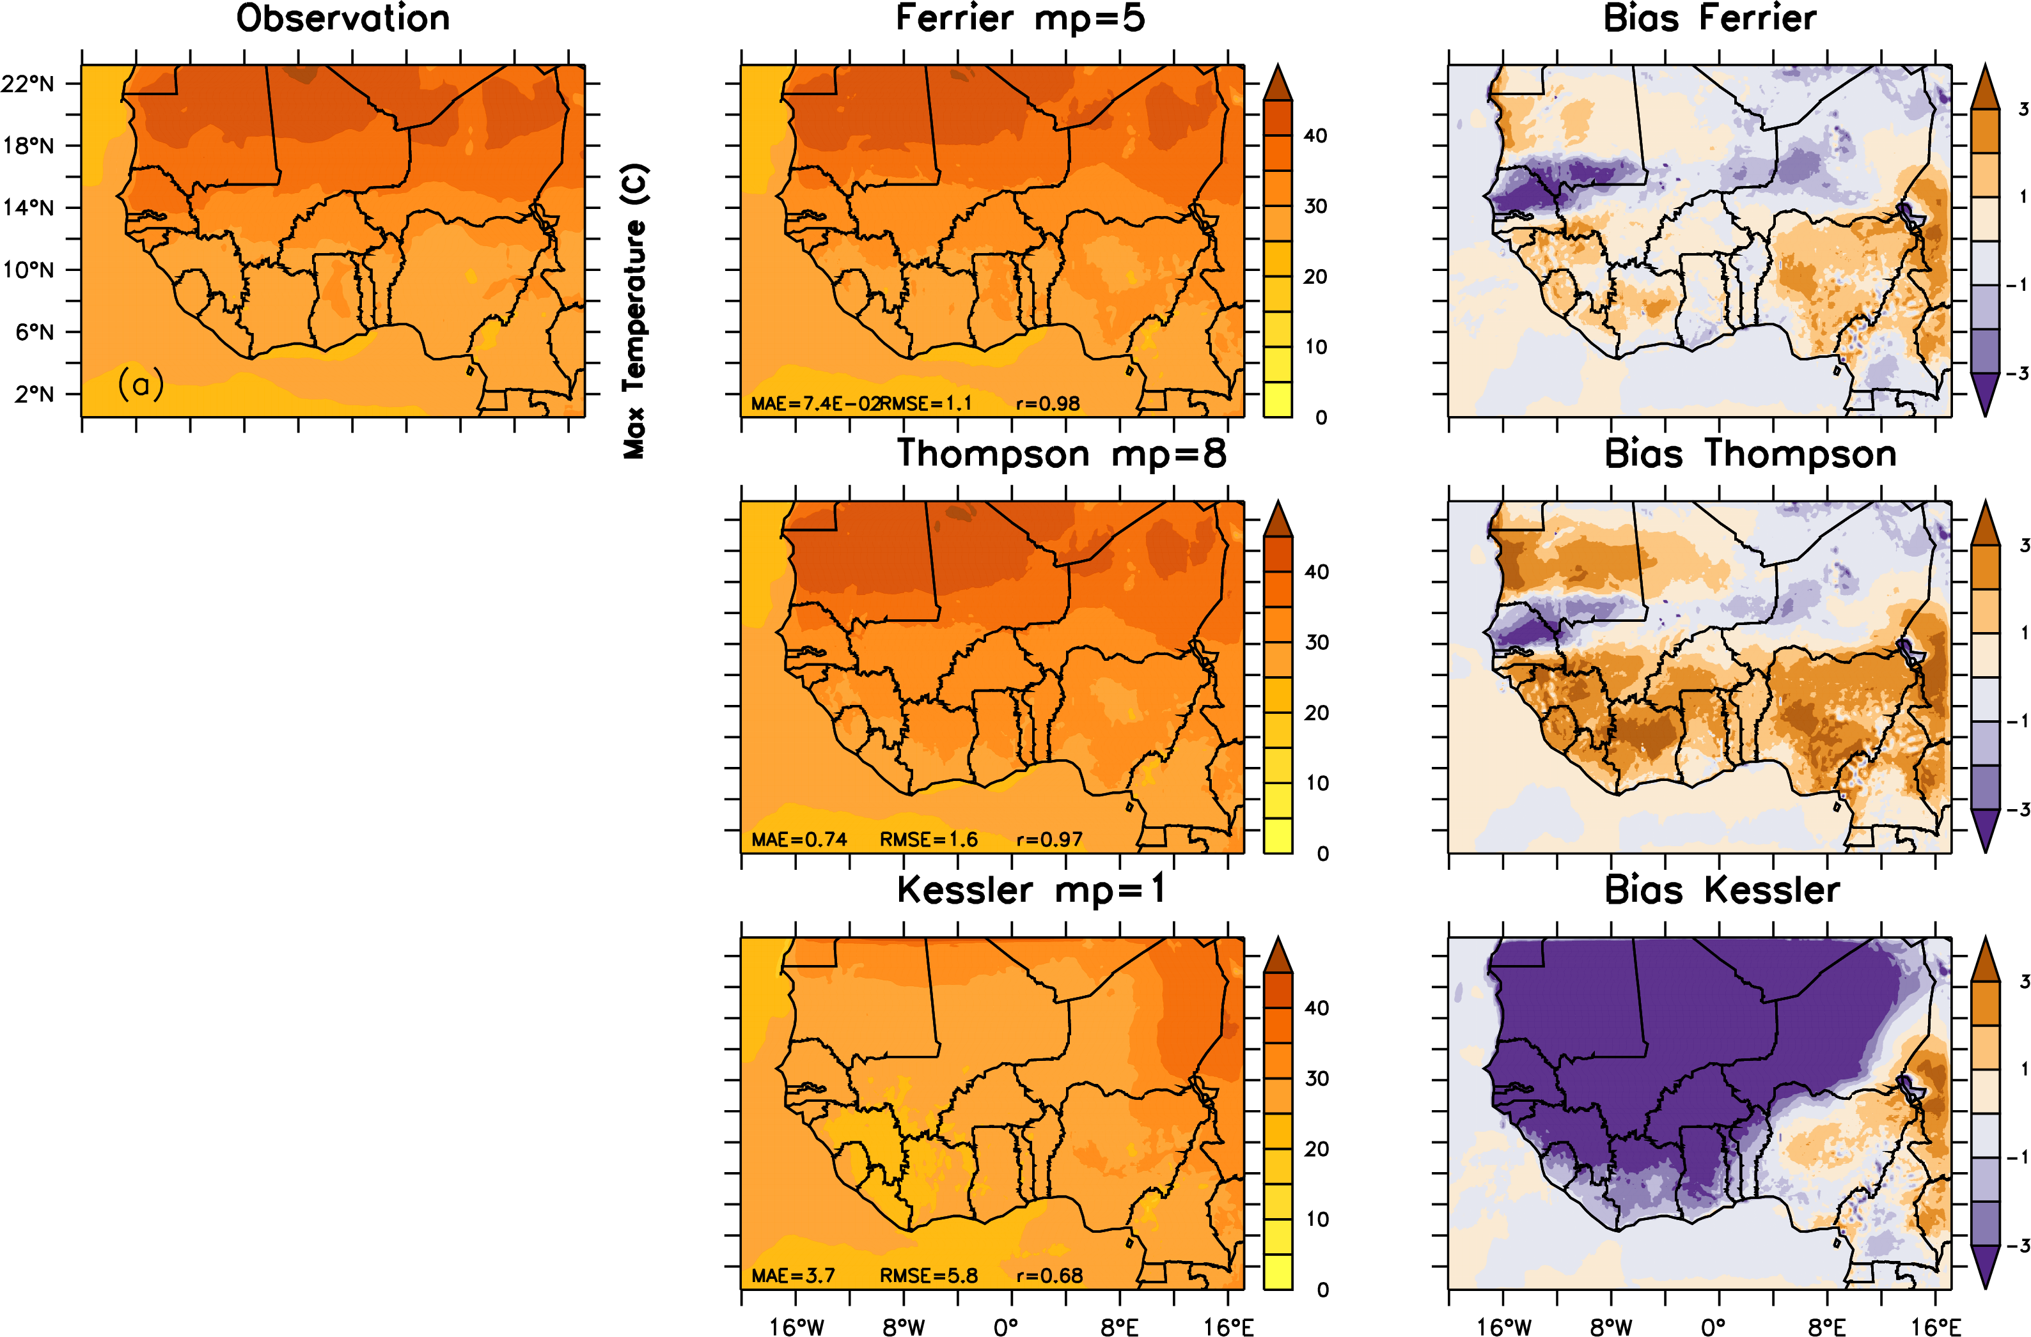
INTRODUCTION
DATA AND METHODS
RESULTS AND DISCUSSIONS
CONCLUSIONS AND RECOMMANDATIONS
BACKGROUND OF THE STUDY
STUDY AREA
OBJECTIVES
MAXIMUM TEMPERATURE
Notes:
Climate modeling is crucial for understanding the dynamics of climate change.
Microphysics schemes in the WRF (Weather Research and Forecasting) model play a significant role in the accuracy of climate simulations.
This study evaluates the performance of different microphysics schemes in WRF for simulating precipitation, temperature (Tmax, Tmin), and solar radiation (SWDOWN) over West Africa.
Evaluate the performance of different microphysics schemes in WRF (Kessler, Ferrier, Thompson) for key climate variables (Tmax, Tmin, Precipitation, SWDOWN).
Compare WRF model outputs with observational data (SARAH, CHIRPS, ERA5) for West Africa.
Assess model biases and recommend the most suitable microphysics scheme for each variable.
The study focuses on West Africa, a region with diverse climates ranging from arid to tropical.
West Africa is highly vulnerable to the impacts of climate change, particularly in terms of temperature, rainfall variability, and extreme weather events.
Accurate climate projections are crucial for planning and adaptation strategies in this region.
Model: WRF (Weather Research and Forecasting) model with three microphysics schemes (Kessler, Ferrier, Thompson).
Observational Data:
Precipitation: CHIRPS dataset.
Solar Radiation: SARAH dataset.
Temperature: ERA5 reanalysis data (Tmax, Tmin).
Study period: from 2 to 11 August 2019
WRF model configuration:
Resolution: one Domain with 15 km resolution, grid size 284 x 174
Microphysics schemes tested: Kessler (mp=1), Ferrier (mp=5), Thompson (mp=8).
Comparison metrics: Mean Absolute Error (MAE), Root Mean Square Error (RMSE), and Bias.
Evaluation conducted for Tmin, Tmax, precipitation, and SWDOWN against observations from SARAH, CHIRPS, and ERA5.

Slide 4
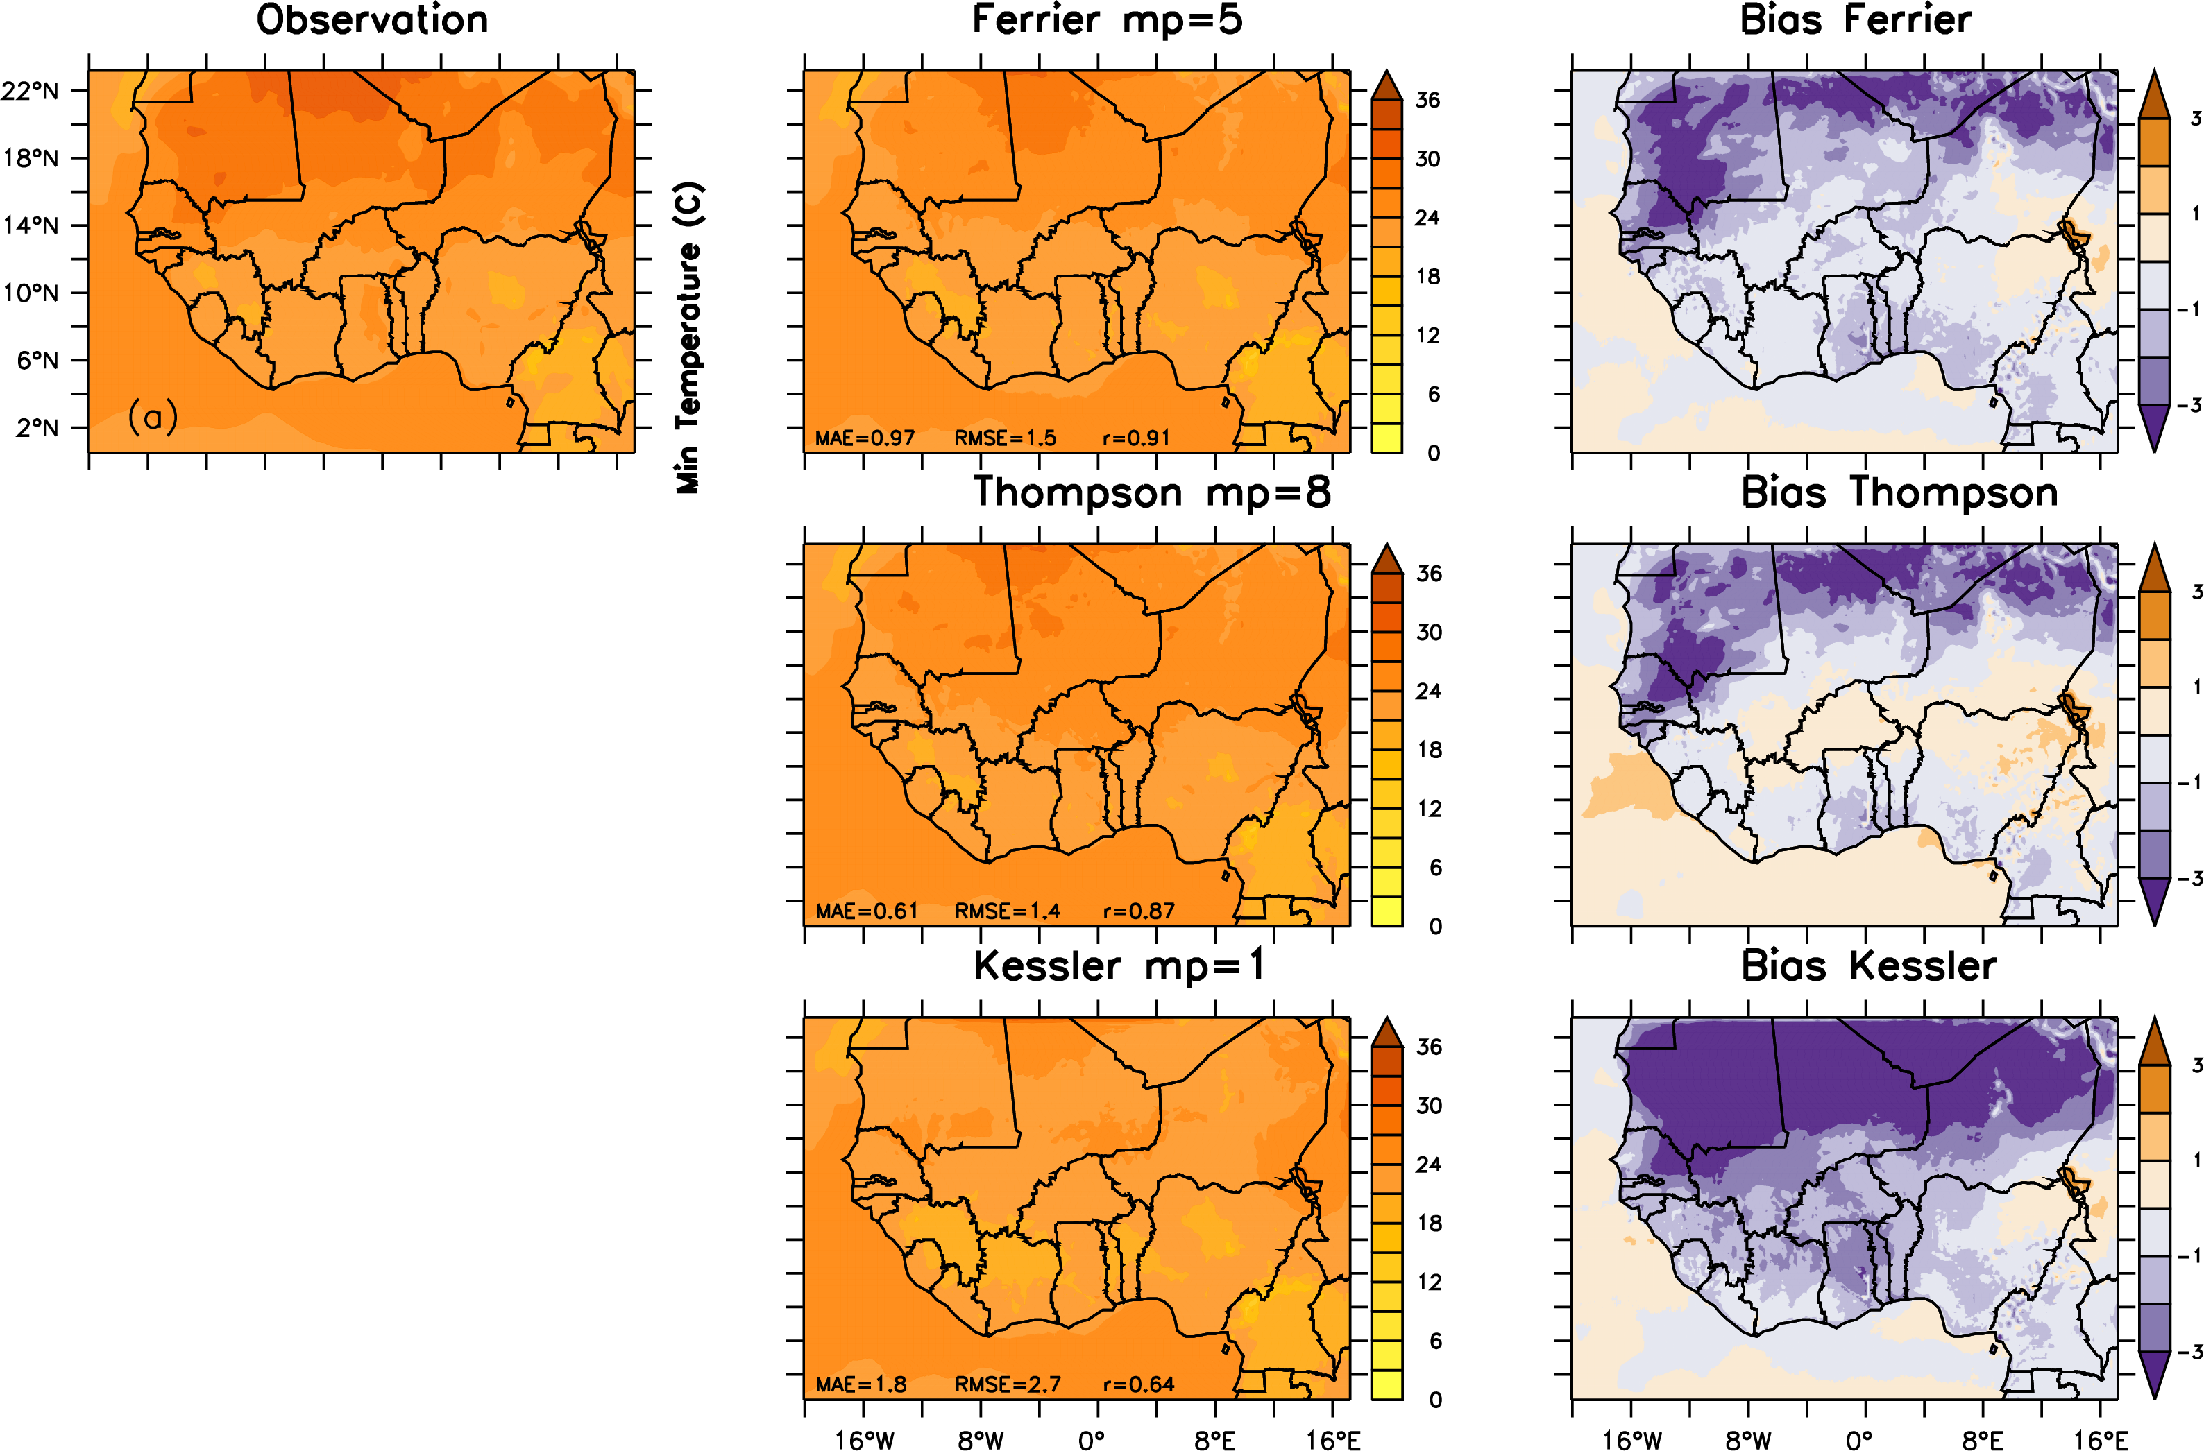
INTRODUCTION
DATA AND METHODS
RESULTS AND DISCUSSIONS
CONCLUSIONS AND RECOMMANDATIONS
BACKGROUND OF THE STUDY
STUDY AREA
OBJECTIVES
MINIMUM TEMPERATURE

Slide 5
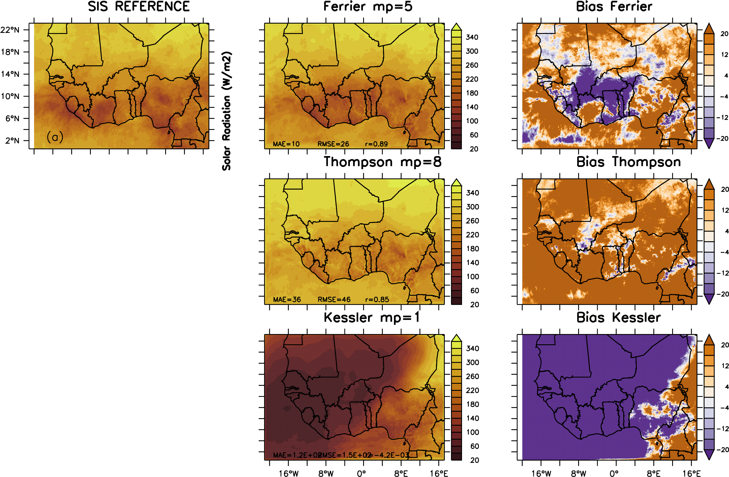
INTRODUCTION
DATA AND METHODS
RESULTS AND DISCUSSIONS
CONCLUSIONS AND RECOMMANDATIONS
BACKGROUND OF THE STUDY
STUDY AREA
OBJECTIVES
SOLAR RADIATION

Slide 6
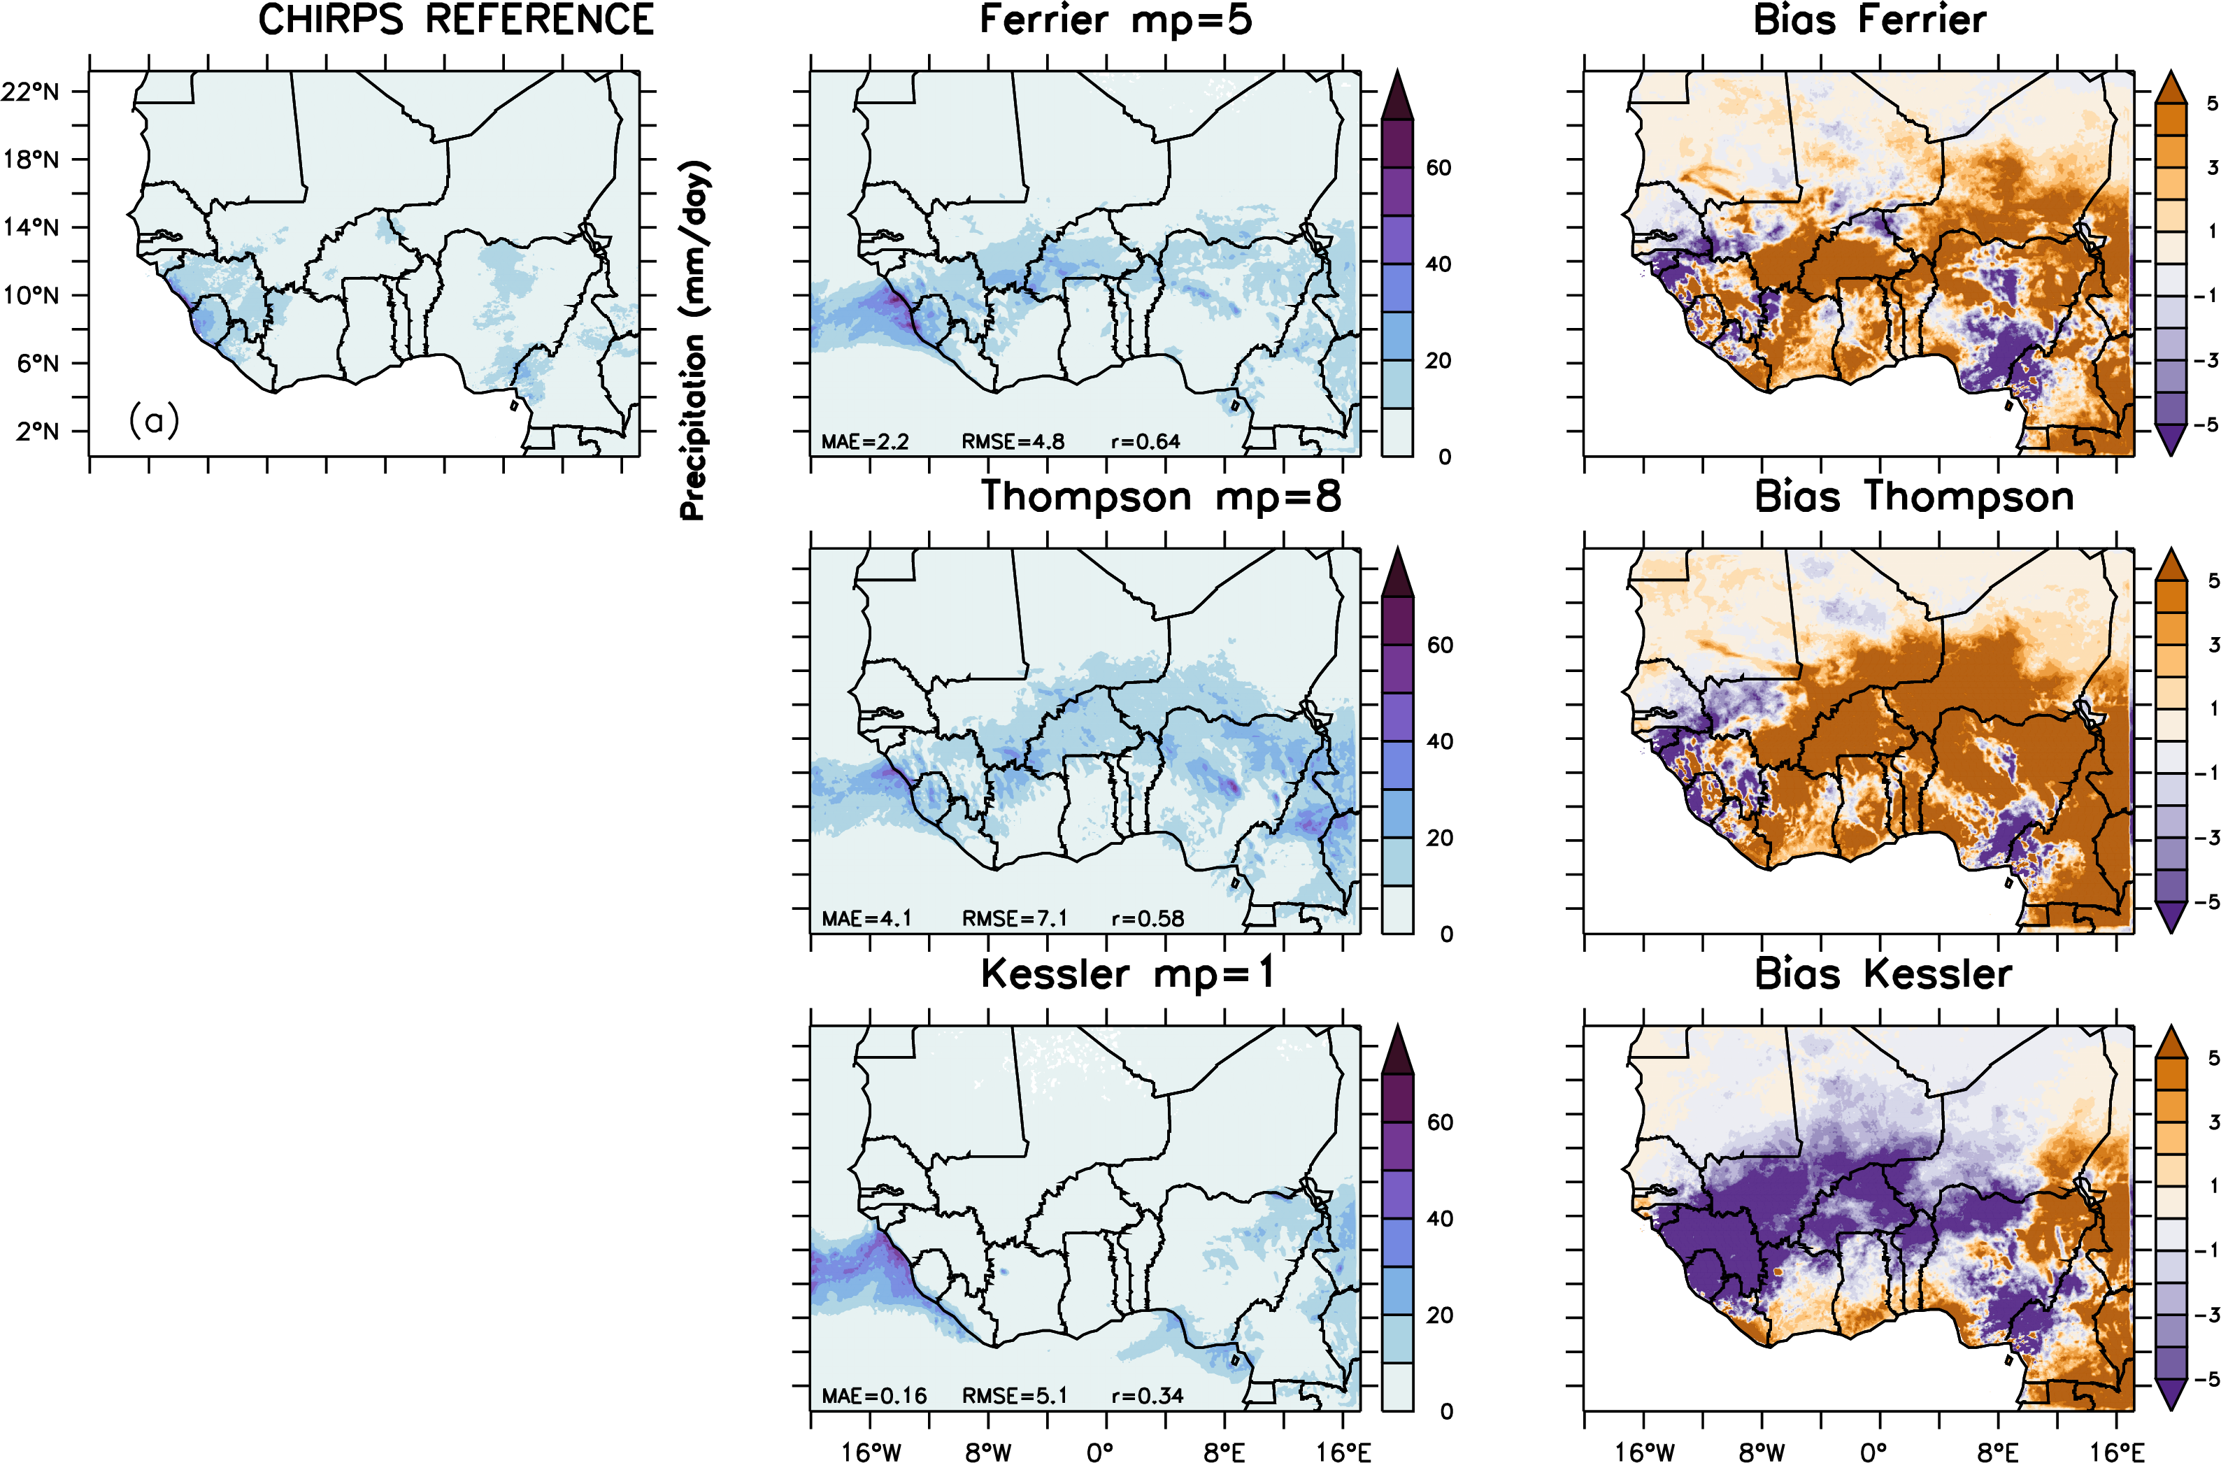
INTRODUCTION
DATA AND METHODS
RESULTS AND DISCUSSIONS
CONCLUSIONS AND RECOMMANDATIONS
BACKGROUND OF THE STUDY
STUDY AREA
OBJECTIVES
PRECIPITATION

Slide 7
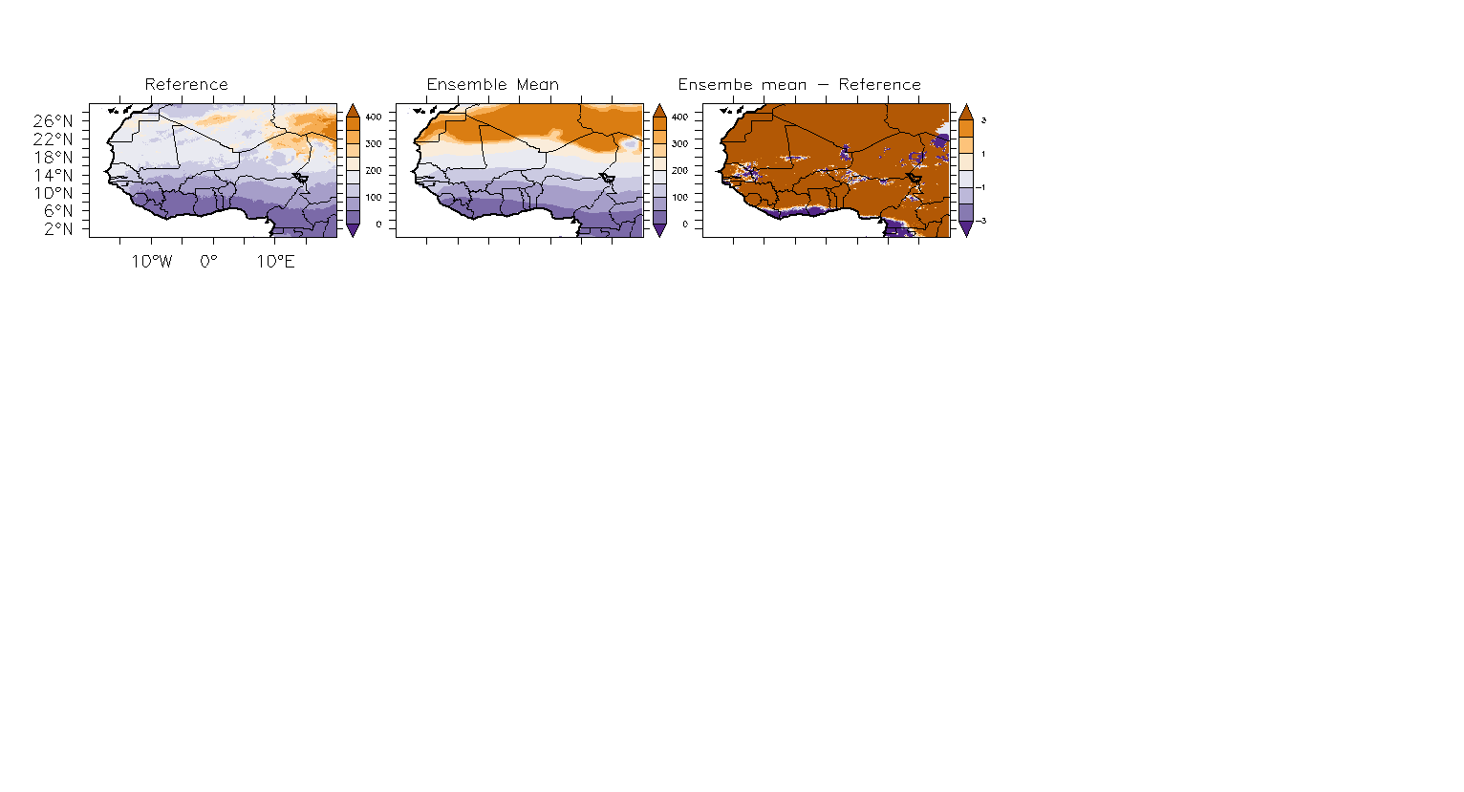
Model Evaluation
INTRODUCTION
DATA AND METHODS
RESULTS AND DISCUSSIONS
CONCLUSIONS AND RECOMMANDATIONS
BACKGROUND OF THE STUDY
STUDY AREA
OBJECTIVES
Bias = Ensemble Mean - Reference

Slide 8
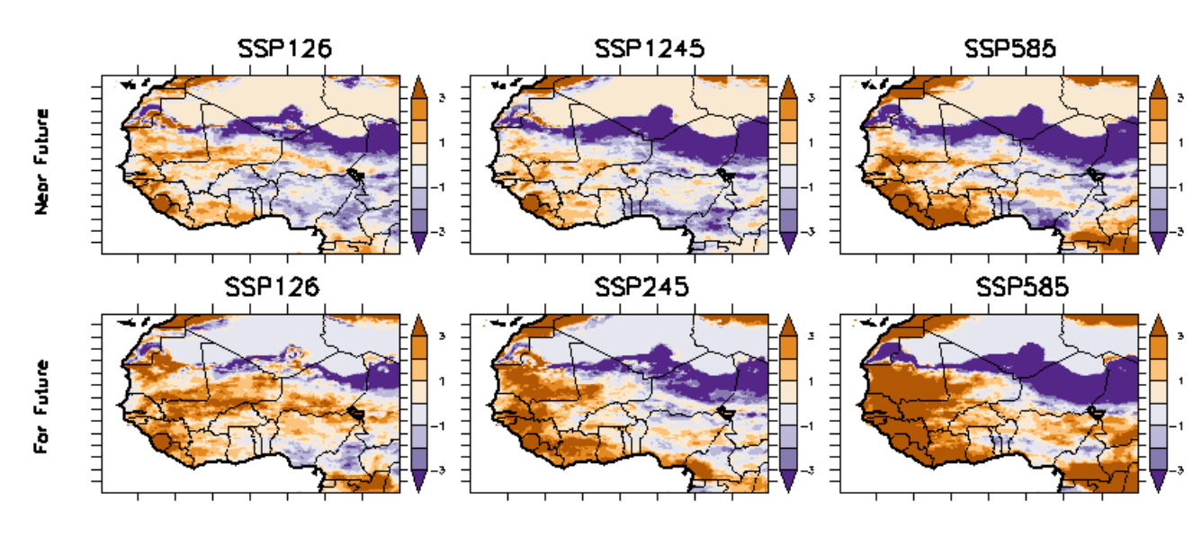
Model Projection
INTRODUCTION
DATA AND METHODS
RESULTS AND DISCUSSIONS
CONCLUSIONS AND RECOMMANDATIONS
BACKGROUND OF THE STUDY
STUDY AREA
OBJECTIVES

Slide 9
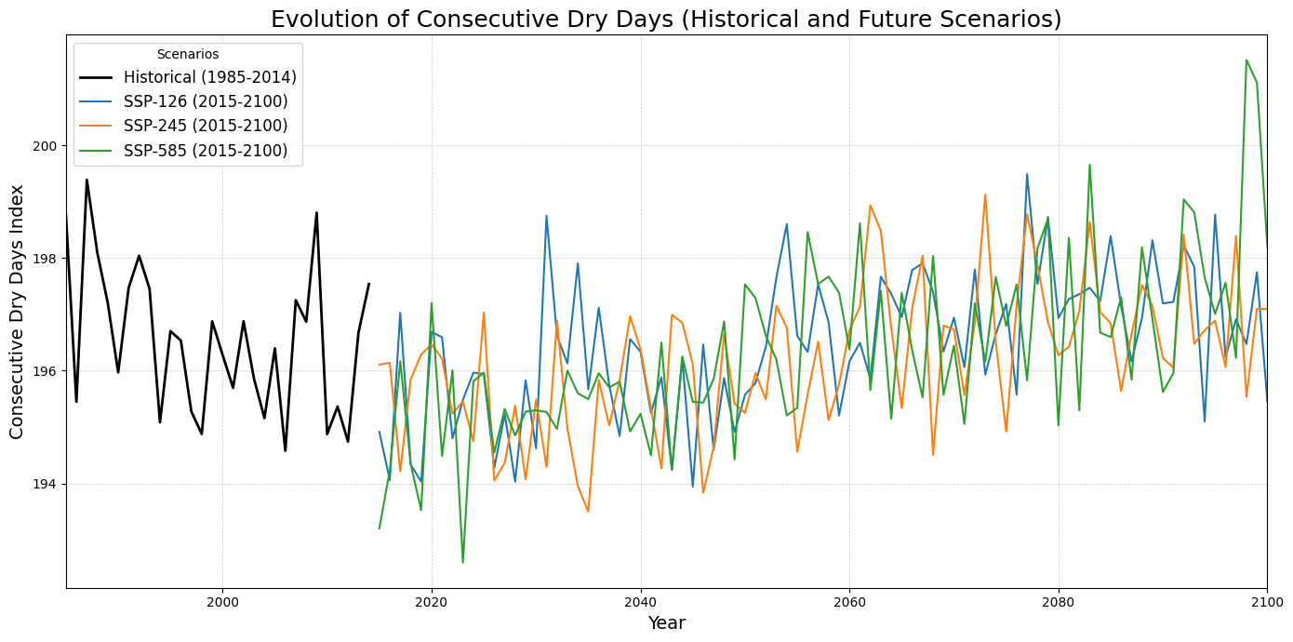
Evolution of Consecutives dry day
INTRODUCTION
DATA AND METHODS
RESULTS AND DISCUSSIONS
CONCLUSIONS AND RECOMMANDATIONS
BACKGROUND OF THE STUDY
STUDY AREA
OBJECTIVES

